Slide 1
Spanning Tree Congestion
Sunil Chandran L
Joint work with
Davis Issac Yun Kuen (Marco) Cheung
Notes:
1

Slide 3
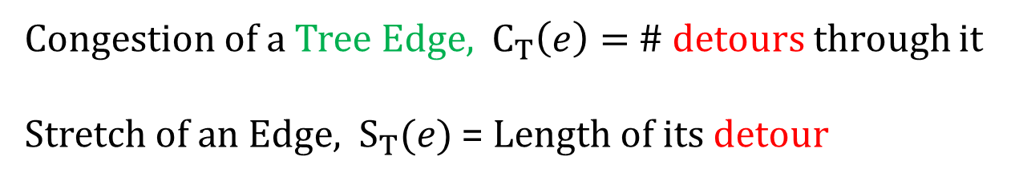
Congestion of a Tree Edge, $C_{T}\left(e\right)=$ # detours through it
Stretch of an Edge, $S_{T}(e)$ = Length of its detour
Detour of an edge

Slide 4

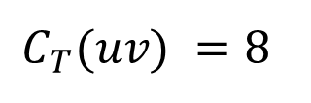
Cut Based Definition of Congestion
v
$$C_{T}(uv) =8$$
u

Slide 5
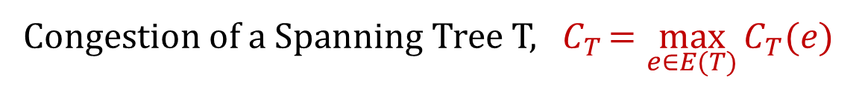
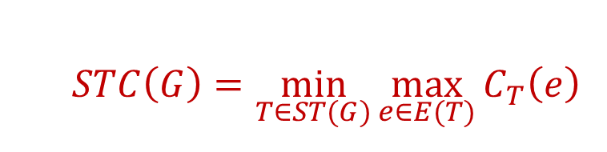
Spanning Tree Congestion
Congestion of a Spanning Tree T, ${ C}_{T }=\max_{e∈E(T)}{C_{T}(e)}$
Spanning Tree Congestion of the Graph, STC$(G)$ = $\min_{T∈ST(G)}{C_{T}}$
  $$STC\left(G\right)=\min_{T∈ST(G)}{\max_{e∈E(T)}{C_{T}\left(e\right)}}$$

Slide 6

Some Related Problems
  $$STC\left(G\right)=\min_{T∈ST(G)}{\max_{e∈E(T)}{C_{T}\left(e\right)}}$$

Slide 7
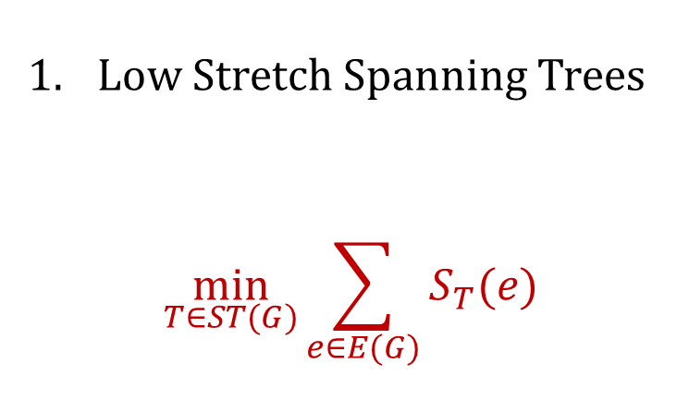
Some Related Problems
  $$STC\left(G\right)=\min_{T∈ST(G)}{\max_{e∈E(T)}{C_{T}\left(e\right)}}$$
Low Stretch Spanning Trees
$\min_{T∈ST(G)}{\sum_{e∈E(G)}{S_{T}(e)}}$

Slide 8
Some Related Problems
  $$STC\left(G\right)=\min_{T∈ST(G)}{\max_{e∈E(T)}{C_{T}\left(e\right)}}$$
Low Stretch Spanning Trees
$\min_{T∈ST(G)}{\sum_{e∈E(G)}{S_{T}(e)}}$
Total Congestion of T = Total Stretch with respect to T

Slide 9

Some Related Problems
  $$STC\left(G\right)=\min_{T∈ST(G)}{\max_{e∈E(T)}{C_{T}\left(e\right)}}$$
Low Stretch Spanning Trees (Min Sum Congestion/Stretch)
$\min_{T∈ST(G)}{\sum_{e∈E(G)}{S_{T}(e)}}=\min_{T∈ST(G)}{\sum_{e∈E\left(T\right)}{C_{T}(e)}}$

Slide 10
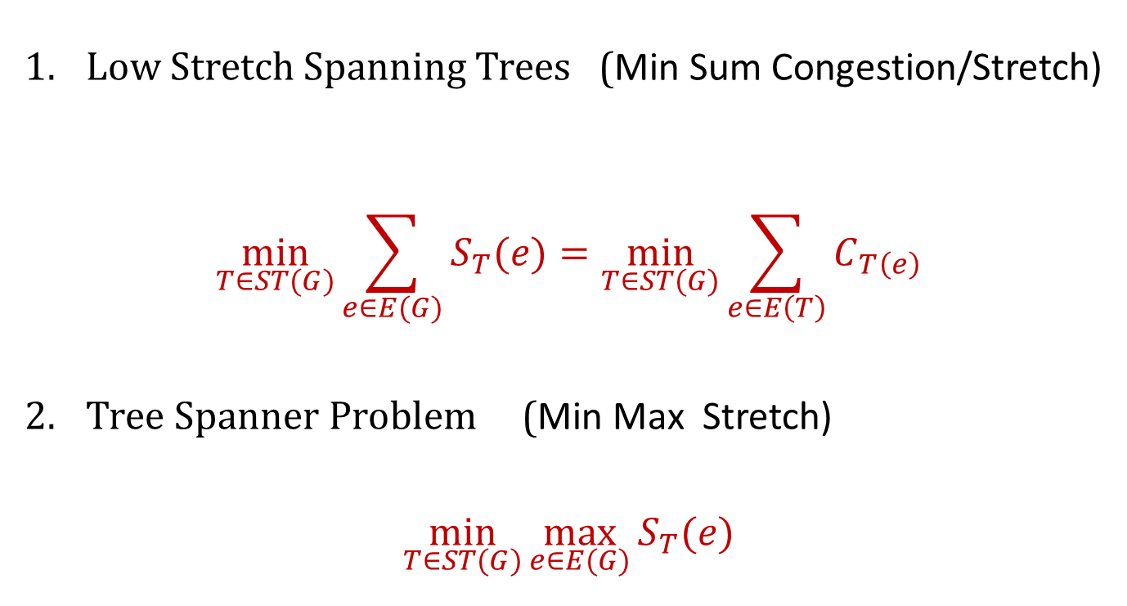
Some Related Problems
  $$STC\left(G\right)=\min_{T∈ST(G)}{\max_{e∈E(T)}{C_{T}\left(e\right)}}$$
Low Stretch Spanning Trees (Min Sum Congestion/Stretch)
$\min_{T∈ST(G)}{\sum_{e∈E(G)}{S_{T}(e)}}=\min_{T∈ST(G)}{\sum_{e∈E\left(T\right)}{C_{T\left(e\right)}}}$
Tree Spanner Problem (Min Max Stretch)
$\min_{T∈ST(G)}{\max_{e∈E(G)}{S_{T}(e)}}$

Slide 11
STC of some simple Graphs
Tree
STC=1
Clique
STC=n-1

Slide 12
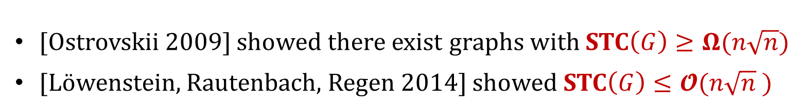
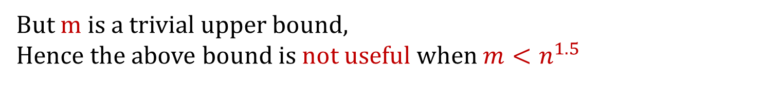
[Ostrovskii 2009] showed there exist graphs with STC$\left(G\right)≥Ω(n\sqrt{n})$
[Löwenstein, Rautenbach, Regen 2014] showed STC$\left(G\right)≤𝓞(n\sqrt{n} )$
But m is a trivial upper bound,
Hence the above bound is not useful when $m<n^{1.5}$

Slide 13
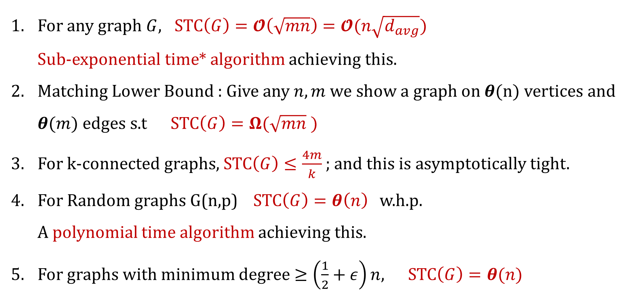
Our Results
For any graph $G$, STC$\left(G\right)=𝓞\left(\sqrt{mn}\right)=𝓞(n\sqrt{d_{avg}})$
Sub-exponential time* algorithm achieving this.
Matching Lower Bound : Give any $n,m$we show a graph on $θ(n)$ vertices and $θ(m)$ edges s.t STC$\left(G\right)=Ω(\sqrt{mn} )$
For k-connected graphs, STC$\left(G\right)≤\frac{4m}{k}$ ; and this is asymptotically tight.
For Random graphs G(n,p) STC$\left(G\right)=θ\left(n\right)$w.h.p.
A polynomial time algorithm achieving this.
For graphs with minimum degree $≥\left(\frac{1}{2}+ε\right)n$, STC$\left(G\right)=θ(n)$

Slide 14
Comparison with Related Problems
Min Sum Congestion/Stretch | Min Max Stretch | Min Max Congestion

Slide 15
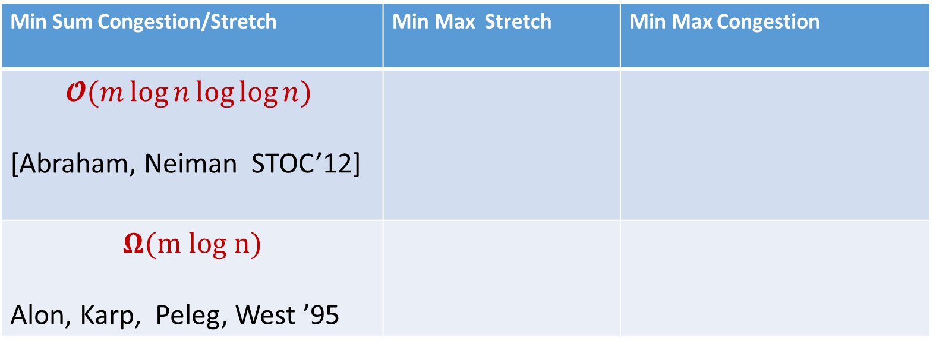
Comparison with Related Problems
Min Sum Congestion/Stretch | Min Max Stretch | Min Max Congestion
$$𝓞(m\log{n\log{\log{n}}})$$ [Abraham, Neiman STOC’12]
$$Ω(m log n)$$ Alon, Karp, Peleg, West ’95

Slide 16
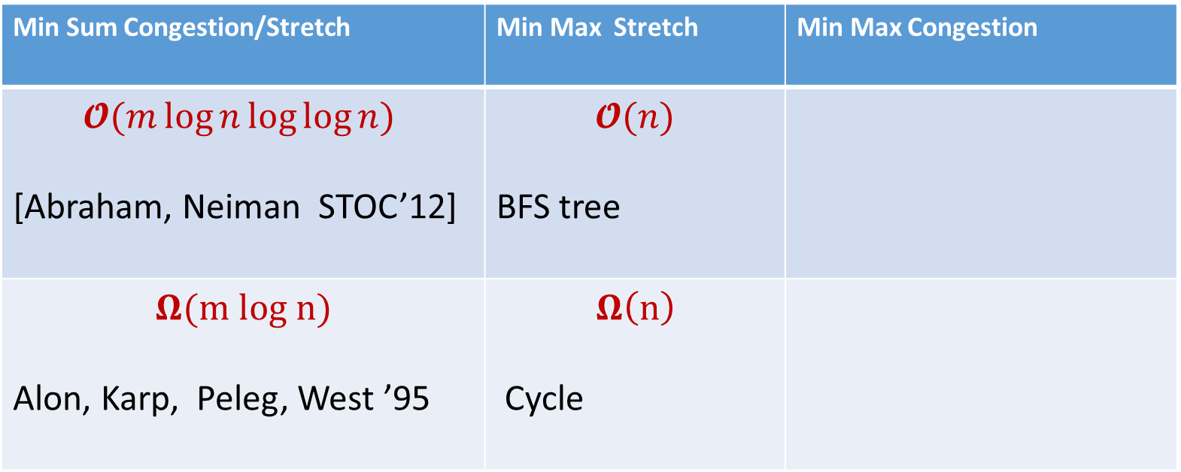
Comparison with Related Problems
Min Sum Congestion/Stretch | Min Max Stretch | Min Max Congestion
$$𝓞(m\log{n\log{\log{n}}})$$ [Abraham, Neiman STOC’12] | $$𝓞(n)$$ BFS tree
$$Ω(m log n)$$ Alon, Karp, Peleg, West ’95 | $$Ω\left(n\right)$$ Cycle

Slide 17
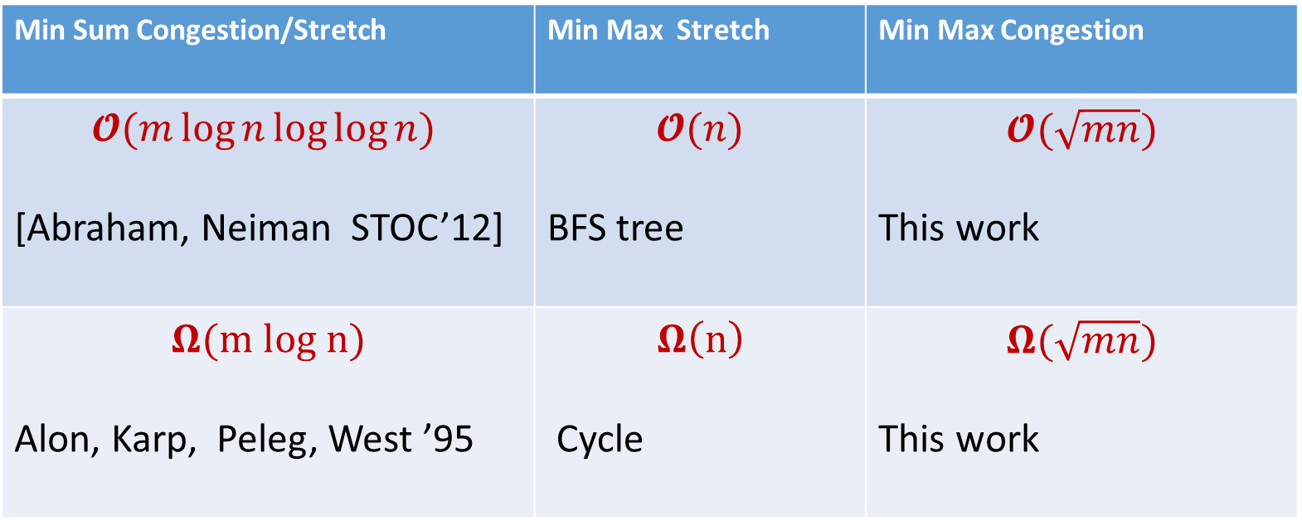
Comparison with Related Problems
Min Sum Congestion/Stretch | Min Max Stretch | Min Max Congestion
$$𝓞(m\log{n\log{\log{n}}})$$ [Abraham, Neiman STOC’12] | $$𝓞(n)$$ BFS tree | $$𝓞(\sqrt{mn})$$ This work
$$Ω(m log n)$$ Alon, Karp, Peleg, West ’95 | $$Ω\left(n\right)$$ Cycle | $$Ω(\sqrt{mn})$$ This work

Slide 18

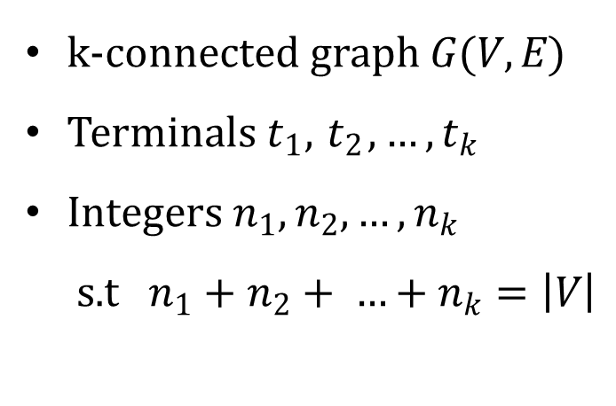




Győri-Lovász Theorem (1976)
Given
$$t_{1}$$
k-connected graph $G(V,E)$
Terminals $t_{1},{ t}_{2}, …,t_{k}$
Integers $n_{1},n_{2},…,n_{k}$
s.t $n_{1}+n_{2}+ …+n_{k}=\left|V\right|$
$$G$$
$$t_{2}$$
$$t_{k}$$
$$t_{3}$$

Slide 19



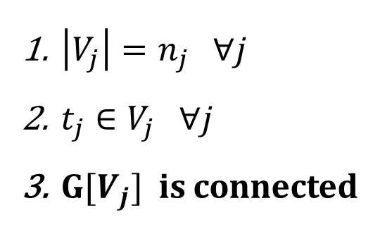
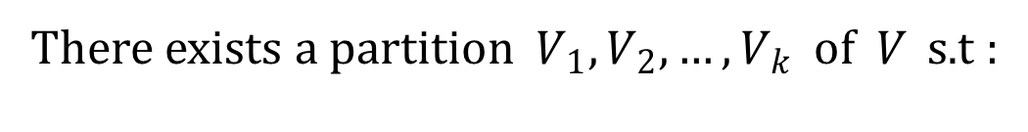

Győri-Lovász Theorem (1976)
Given
k-connected graph $G(V,E)$
Terminals $t_{1},{ t}_{2}, …,t_{k}$
Integers $n_{1},n_{2},…,n_{k}$
s.t $n_{1}+n_{2}+ …+n_{k}=\left|V\right|$
$$G$$
There exists a partition $V_{1},V_{2},…, V_{k}$ of $V$ s.t :
$\left|V_{j}\right|=n_{j} ∀j$
$t_{j}∈V_{j} ∀j$
$G[V_{j}]$ is connected
$$t_{1}$$
$$t_{2}$$
………….
$$t_{k}$$

Slide 20








$𝓞\left(\frac{n^{2}}{k}\right)$ Upper Bound for k-Connected Graphs [Löwenstein et. al 2009]
$$v_{1}$$
$$\frac{n}{k}$$
$$\frac{n}{k}$$
$$\frac{n}{k}$$
$$\frac{n}{k}$$
$$v_{2}$$
$$v_{3}$$
$$v_{k}$$
………….

Slide 21
$𝓞\left(\frac{n^{2}}{k}\right)$ Upper Bound for k-Connected Graphs [Löwenstein et. al 2009]
$$v_{1}$$
$$\frac{n}{k}$$
$$\frac{n}{k}$$
$$\frac{n}{k}$$
$$\frac{n}{k}$$
$$v_{2}$$
$$v_{3}$$
$$v_{k}$$
………….

Slide 22
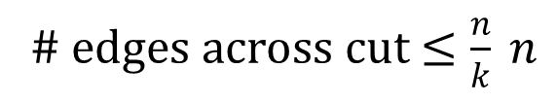
$𝓞\left(\frac{n^{2}}{k}\right)$ Upper Bound for k-Connected Graphs [Löwenstein et. al 2009]
$$v_{1}$$
$$\frac{n}{k}$$
$$\frac{n}{k}$$
$$\frac{n}{k}$$
$$\frac{n}{k}$$
$$v_{2}$$
$$v_{3}$$
$$v_{k}$$
………….
# edges across cut $≤\frac{n}{k} n$

Slide 23
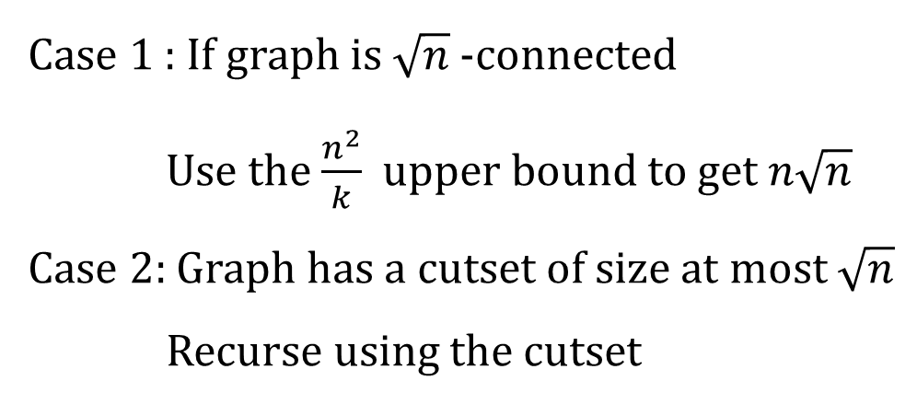
$𝓞\left(n\sqrt{n}\right)$ Upper Bound for STC [Löwenstein et. al 2009]
Case 1 : If graph is $\sqrt{n}$-connected
Use the $\frac{n^{2}}{k}$ upper bound to get $n\sqrt{n}$
Case 2: Graph has a cutset of size at most $\sqrt{n}$
Recurse using the cutset

Slide 24

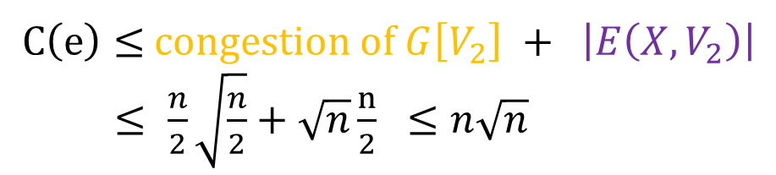


$𝓞\left(n\sqrt{n}\right)$ Upper Bound for STC [Löwenstein et. al 2009]
$$V_{1}$$
$$V_{2}$$
$$\left|X\right|≤\sqrt{n}$$
X
$C\left(e\right)≤$ congestion of $G\left[V_{2}\right] + \left|E\left(X,V_{2}\right)\right|$
$≤ \frac{n}{2}\sqrt{\frac{n}{2}}+\sqrt{n}\frac{n}{2} ≤n\sqrt{n}$

Slide 25
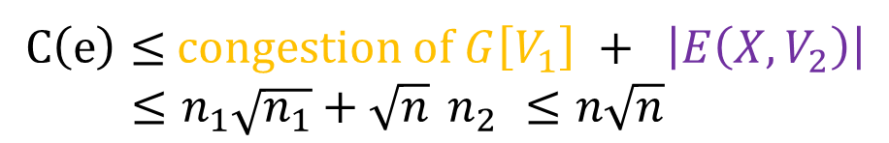
$𝓞\left(n\sqrt{n}\right)$ Upper Bound for STC [Löwenstein et. al 2009]
$$V_{1}$$
$$V_{2}$$
$$\left|X\right|≤\sqrt{n}$$
X
$C\left(e\right)≤$ congestion of $G\left[V_{1}\right] + \left|E\left(X,V_{2}\right)\right|$
$≤n_{1}\sqrt{n_{1}}+\sqrt{n}{ n}_{2} ≤n\sqrt{n}$

Slide 26

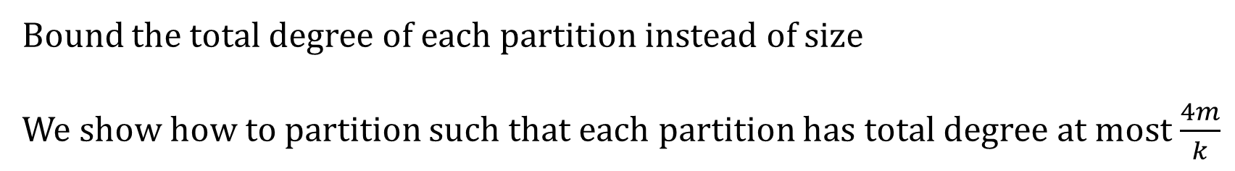



Main Idea for Improved Bound
$$v_{1}$$
$$v_{2}$$
$$v_{3}$$
$$v_{k}$$
………….
Bound the total degree of each partition instead of size
We show how to partition such that each partition has total degree at most $\frac{4m}{k}$

Slide 27
Generalized Győri-Lovász Theorem
J. Chen, D. Kleinberg and L. Lovász gave a non-constructive version of this theorem (J. ACM 54(4): 16, 2007) in a paper named
Tight bounds and existence theorems for single commodity confluent flows.
We give a constructive proof using elementary combinatorial method.

Slide 28
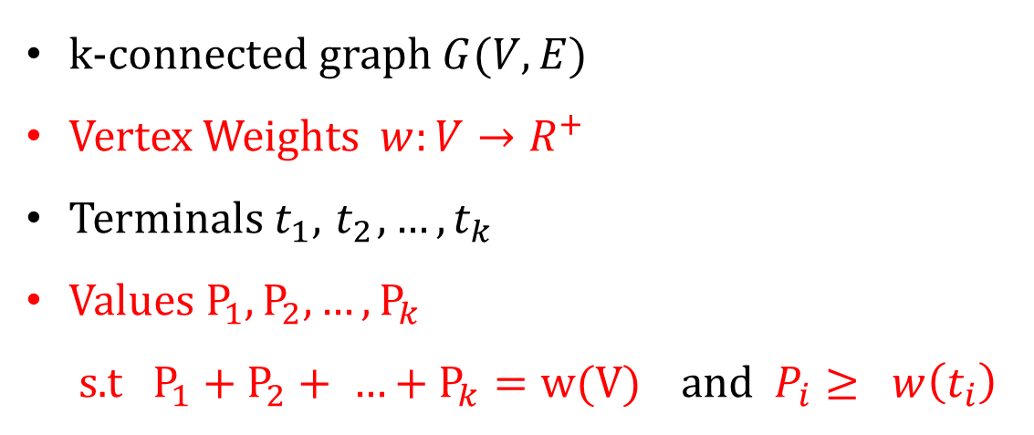
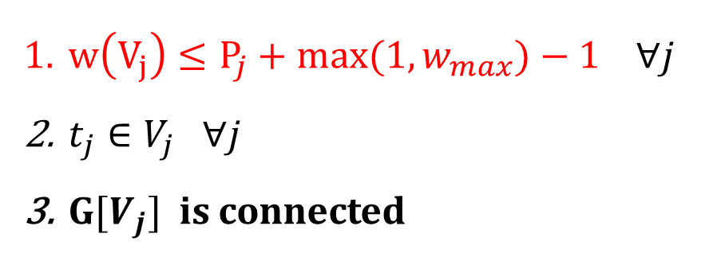
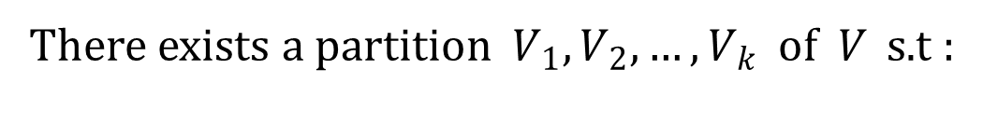
Generalized Győri-Lovász Theorem
Given
k-connected graph $G(V,E)$
Vertex Weights $w:V→R^{+}$
Terminals $t_{1},{ t}_{2}, …,t_{k}$
Values $P_{1},P_{2},…,P_{k}$
s.t $P_{1}+P_{2}+ …+P_{k}=w(V)$ and $P_{i}≥ w\left(t_{i}\right)$
There exists a partition $V_{1},V_{2},…, V_{k}$ of $V$ s.t :
$w\left(V_{j}\right)≤P_{j}+{\max{(1,}w}_{max})−1 ∀j$
$t_{j}∈V_{j} ∀j$
$G[V_{j}]$ is connected

Slide 29
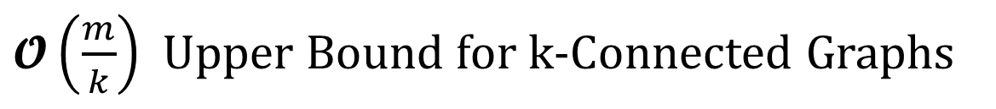
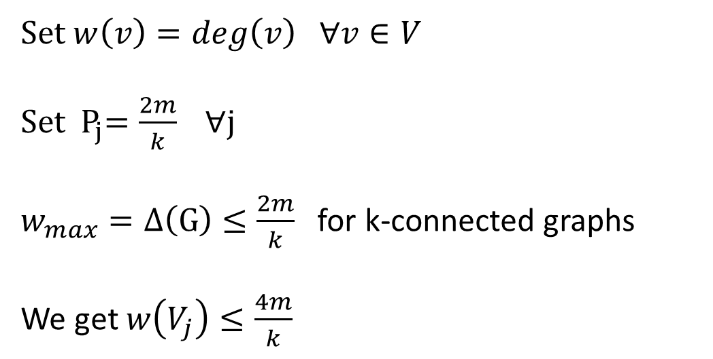
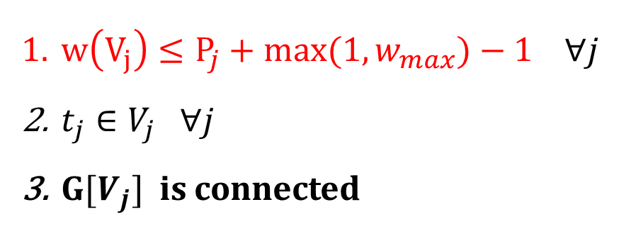
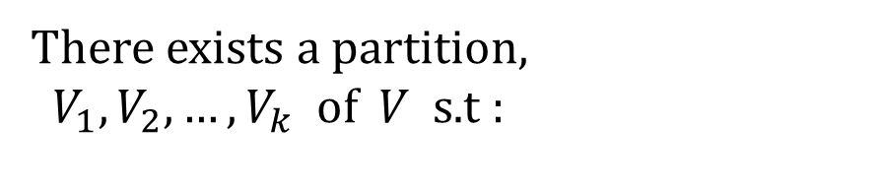
$𝓞\left(\frac{m}{k}\right)$ Upper Bound for k-Connected Graphs
There exists a partition,
$V_{1},V_{2},…, V_{k}$ of $V$ s.t :
Set $w\left(v\right)=deg\left(v\right) ∀v∈V$
Set ${ P}_{j}=\frac{2m}{k} ∀$j
$w_{max}=Δ\left(G\right)≤\frac{2m}{k}$ for k-connected graphs
We get $w\left(V_{j}\right)≤\frac{4m}{k}$
$w\left(V_{j}\right)≤P_{j}+{\max{(1,}w}_{max})−1 ∀j$
$t_{j}∈V_{j} ∀j$
$G[V_{j}]$ is connected

Slide 30
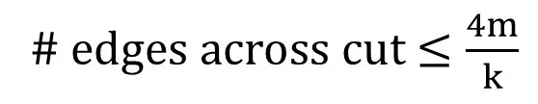
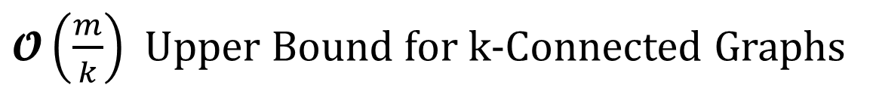
$𝓞\left(\frac{m}{k}\right)$ Upper Bound for k-Connected Graphs
$$v_{1}$$
$$v_{2}$$
$$v_{3}$$
$$v_{k}$$
………….
# edges across cut $≤\frac{4m}{k}$

Slide 31
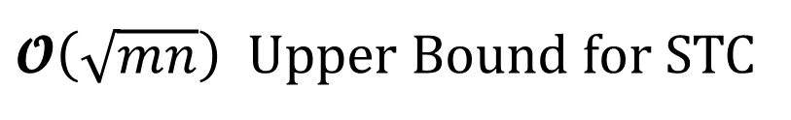
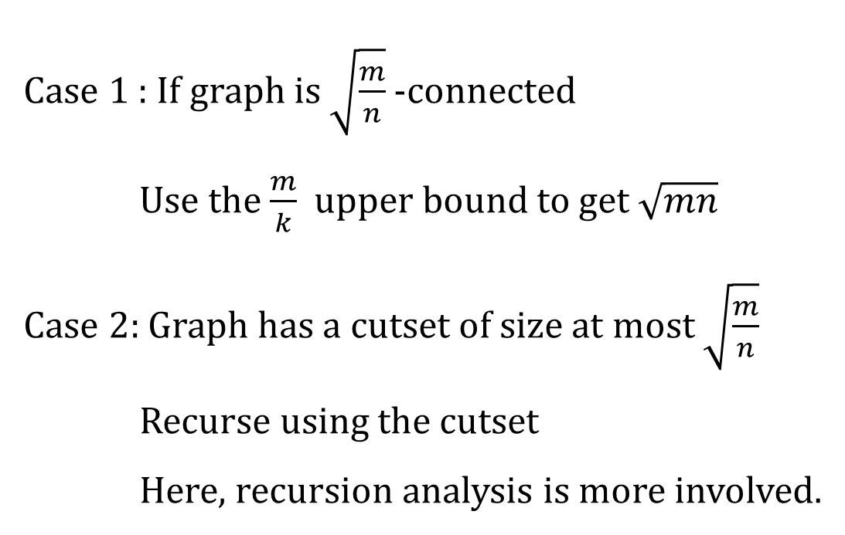
$𝓞\left(\sqrt{mn}\right)$ Upper Bound for STC
Case 1 : If graph is $\sqrt{\frac{m}{n}}$-connected
Use the $\frac{m}{k}$ upper bound to get $\sqrt{mn}$
Case 2: Graph has a cutset of size at most $\sqrt{\frac{m}{n}}$
Recurse using the cutset
Here, recursion analysis is more involved.

Slide 32
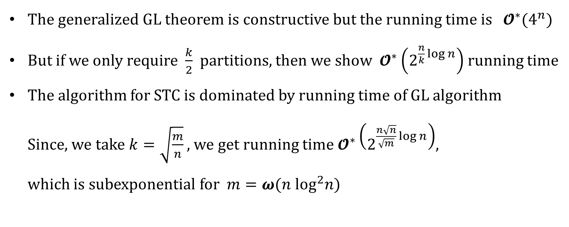
Algorithmic Aspects
The generalized GL theorem is constructive but the running time is $𝓞^{∗}(4^{n})$
But if we only require $\frac{k}{2}$ partitions, then we show $𝓞^{∗}\left(2^{\frac{n}{k}\log{n}}\right)$ running time
The algorithm for STC is dominated by running time of GL algorithm
Since, we take $k=\sqrt{\frac{m}{n}}$ , we get running time $𝓞^{∗}\left(2^{\frac{n\sqrt{n}}{\sqrt{m}}\log{n}}\right)$,
which is subexponential for $m=ω(n \log^{2}n)$

Slide 33


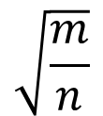


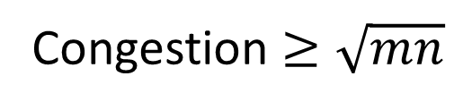
Lower Bound
$G_{1}, G_{2}, G_{3}$ are expanders on $n$ vertices and $m$ edges
$$G_{2}$$
$$G_{3}$$
$$G_{1}$$
Congestion $≥\sqrt{mn}$
$$\sqrt{\frac{m}{n}}$$
$$\sqrt{\frac{m}{n}}$$

Slide 34
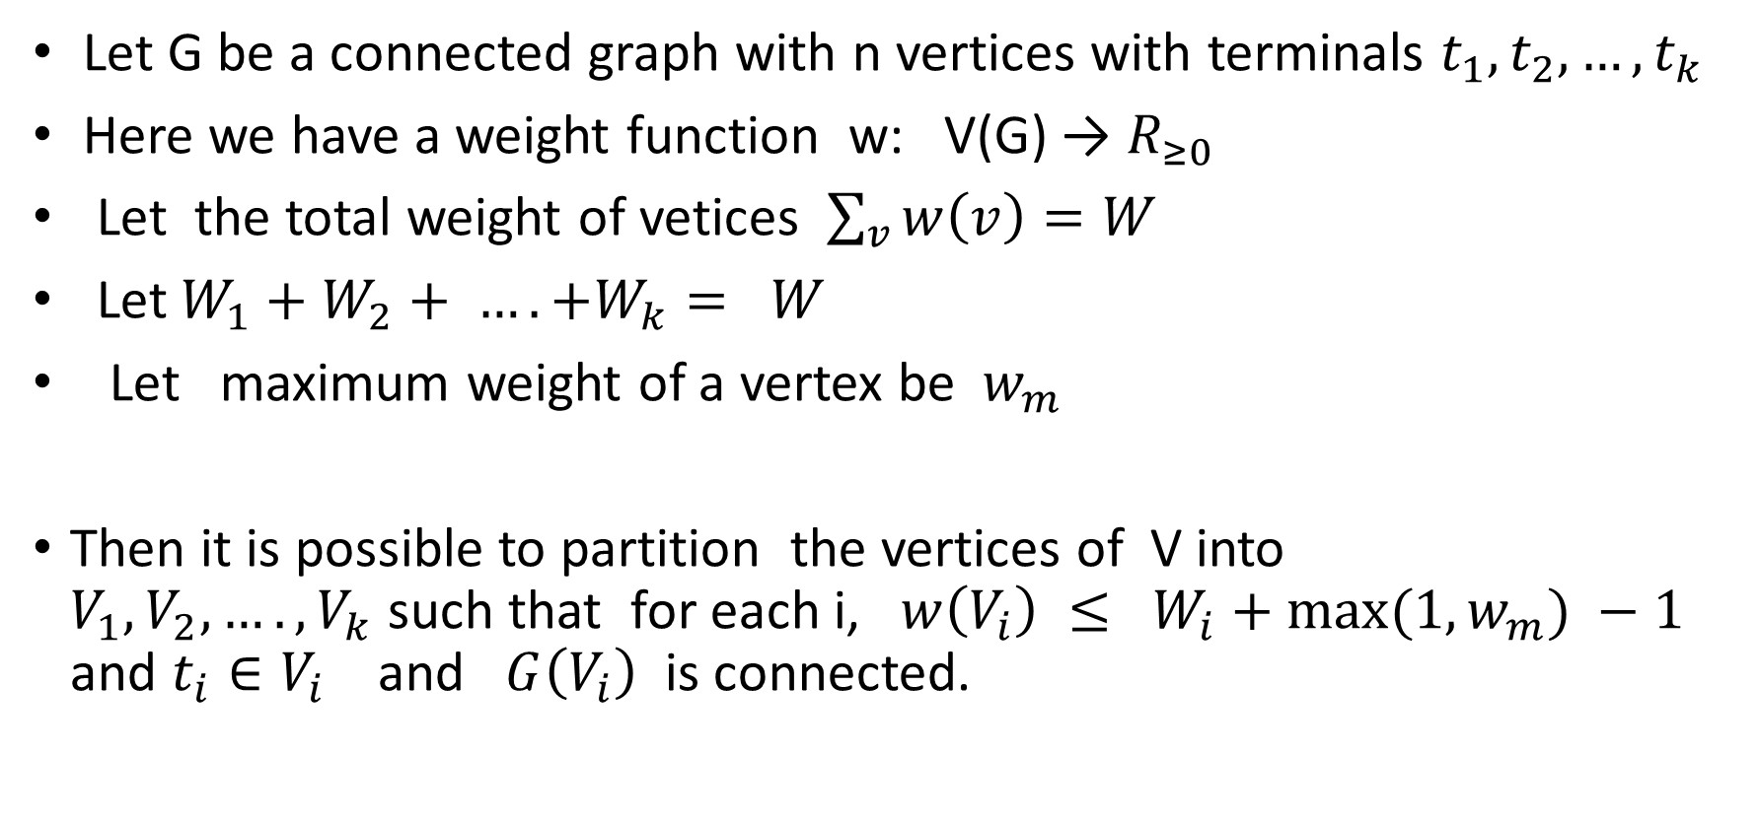
Generalized Győri- Lovász Theorem.
Let G be a connected graph with n vertices with terminals $t_{1}, t_{2},…,t_{k}$
Here we have a weight function w: V(G) → $R_{≥0}$
Let the total weight of vetices $\sum_{v}{w\left(v\right)=W}$
Let $W_{1}+W_{2}+ ….+W_{k}= W$
Let maximum weight of a vertex be $w_{m}$
Then it is possible to partition the vertices of V into $V_{1},V_{2},….,V_{k}$such that for each i, $w\left(V_{i}\right) ≤ W_{i}+{max⁡(1, w}_{m}) −1$ and $t_{i}∈V_{i}$ and $G\left(V_{i}\right)$ is connected.

Slide 35
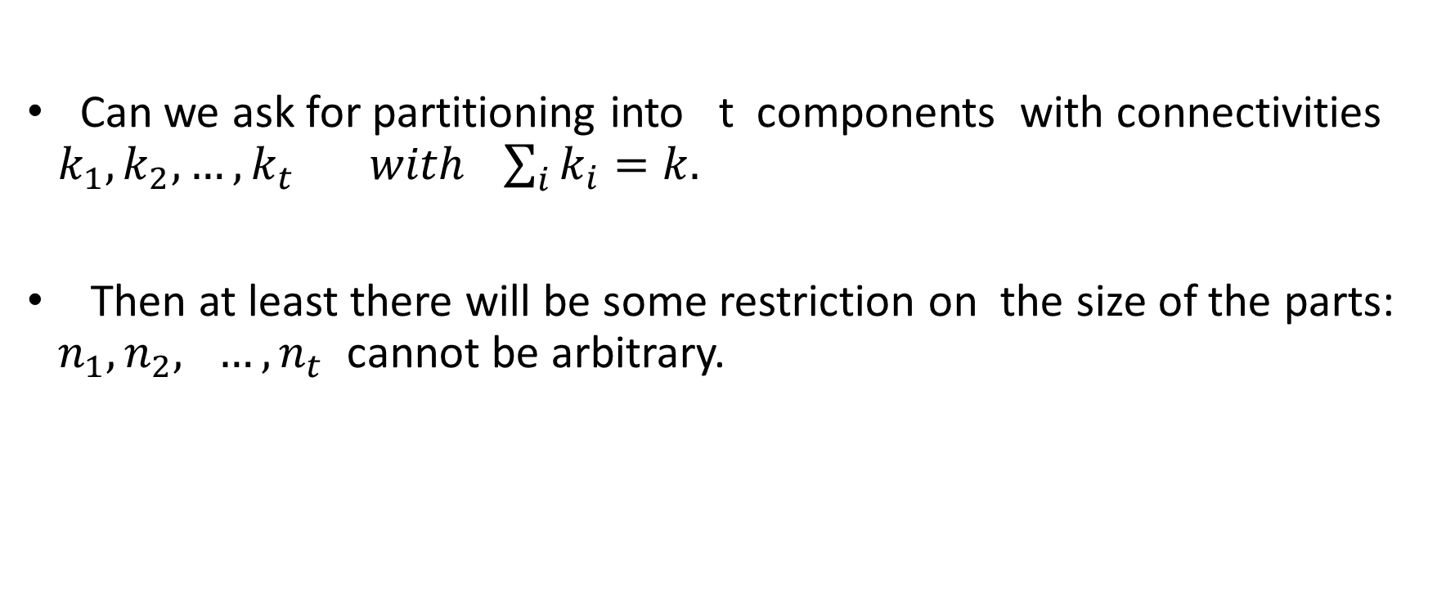
What are the other possible generalizations?
Can we ask for partitioning into t components with connectivities $k_{1},k_{2},…,k_{t} with \sum_{i}{k_{i}=k.}$
Then at least there will be some restriction on the size of the parts: $n_{1},n_{2}, …, n_{t}$ cannot be arbitrary.

Slide 36
What other things can we do with the generalized theorem ?
Consider the following problem:
We want to partition the k-connected graph into
k connected parts such that
(1) At most m/k edges go out of each part
(2) At most n/k vertices in each parts

Slide 37
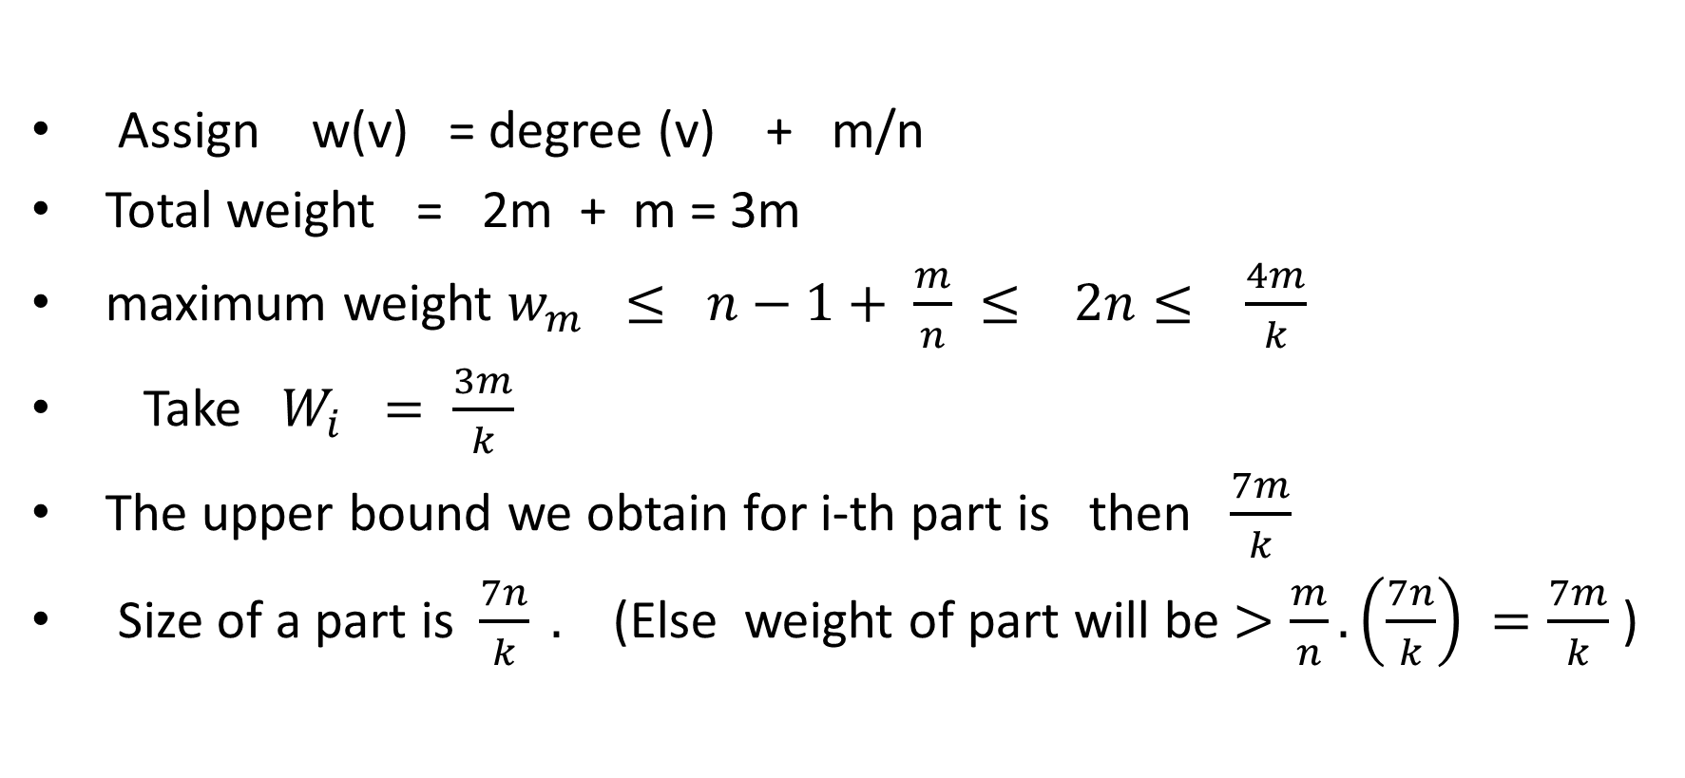
Assign w(v) = degree (v) + m/n
Total weight = 2m + m = 3m
maximum weight $w_{m} ≤ n−1+ \frac{m}{n} ≤ 2n≤ \frac{4m}{k}$
Take $W_{i} = \frac{3m}{k}$
The upper bound we obtain for i-th part is then $\frac{7m}{k}$
Size of a part is $\frac{7n}{k} .$ (Else weight of part will be $>\frac{m}{n}. \left(\frac{7n}{k}\right) =\frac{7m}{k}$)

Slide 38
Assign w(v) = degree (v) + m/n
Total weight = 2m + m = 3m
maximum weight $w_{m} ≤ n−1+ \frac{m}{n} ≤ 2n≤ \frac{4m}{k}$
Take $W_{i} = \frac{3m}{k}$
The upper bound we obtain for i-th part is then $\frac{7m}{k}$
Size of a part is $\frac{7n}{k} .$ (Else weight of part will be $>\frac{m}{n}. \left(\frac{7n}{k}\right) =\frac{7m}{k}$)

Slide 39
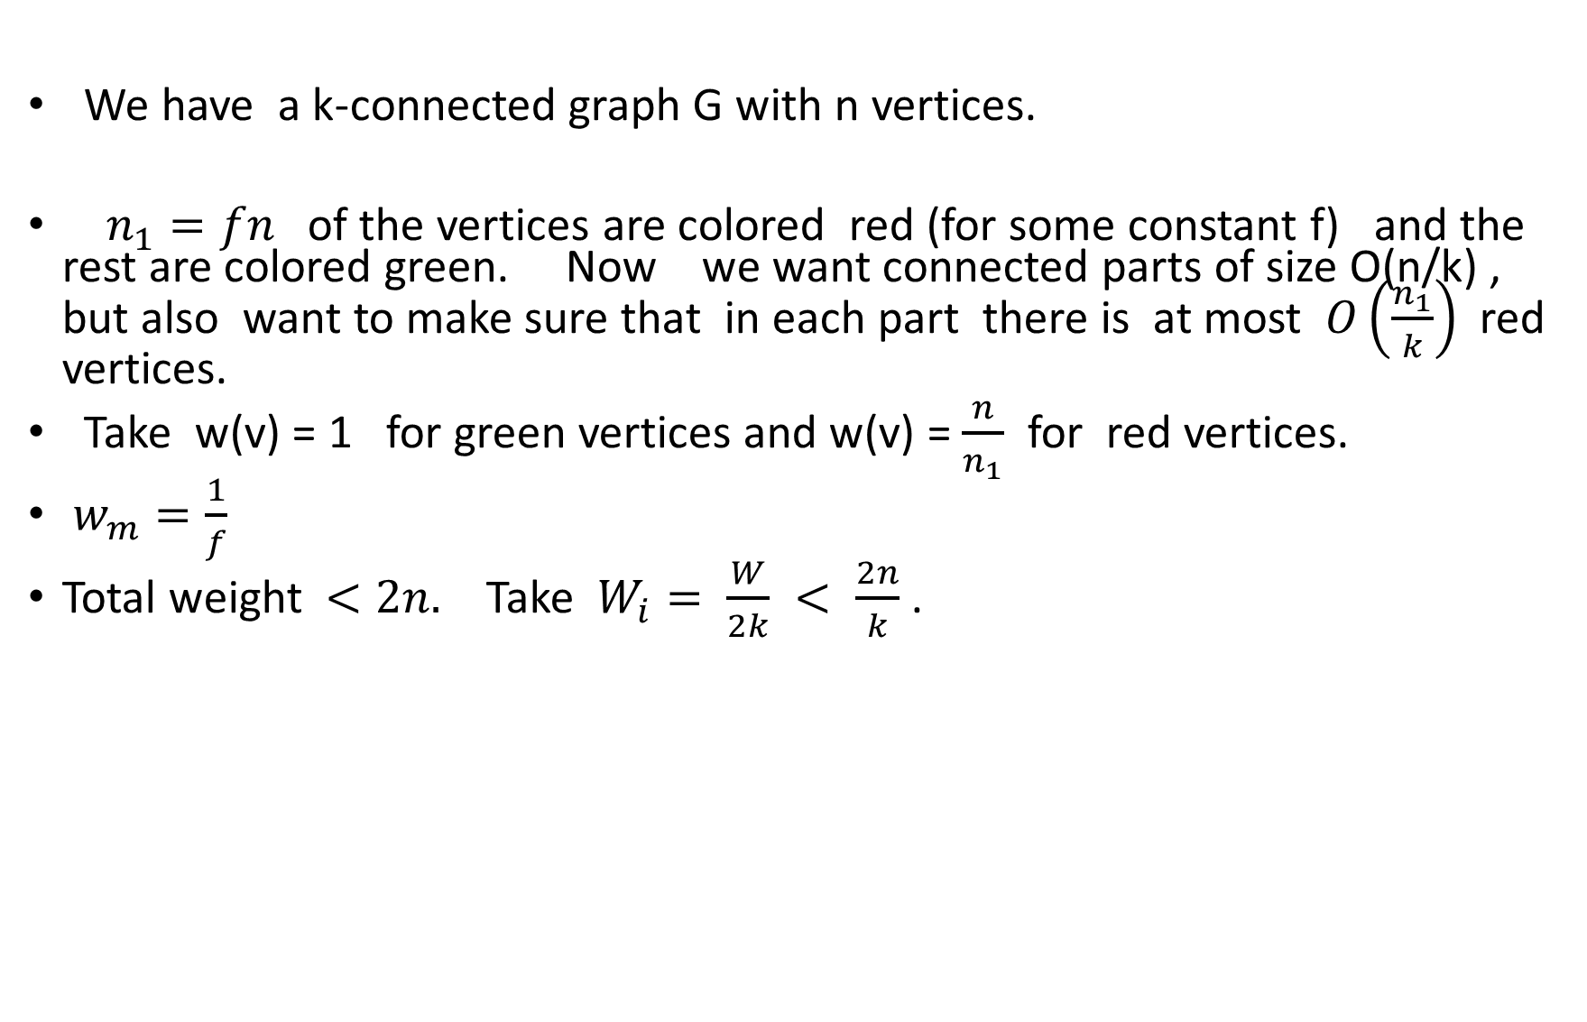
Another question
We have a k-connected graph G with n vertices.
$n_{1}=fn$of the vertices are colored red (for some constant f) and the rest are colored green. Now we want connected parts of size O(n/k) , but also want to make sure that in each part there is at most $O\left(\frac{n_{1}}{k}\right)$red vertices.
Take w(v) = 1 for green vertices and w(v) = $\frac{n}{n_{1}}$ for red vertices.
$w_{m}=\frac{1}{f}$
Total weight $<2n.$ Take $W_{i}= \frac{W}{2k} < \frac{2n}{k}$.

Slide 40

Also partitions with O(m/k) out going edges and $O\left(\frac{n_{1}}{k}\right)$ when $n_{1}=fn$ (for some constant f) special vertices are given.

Slide 41
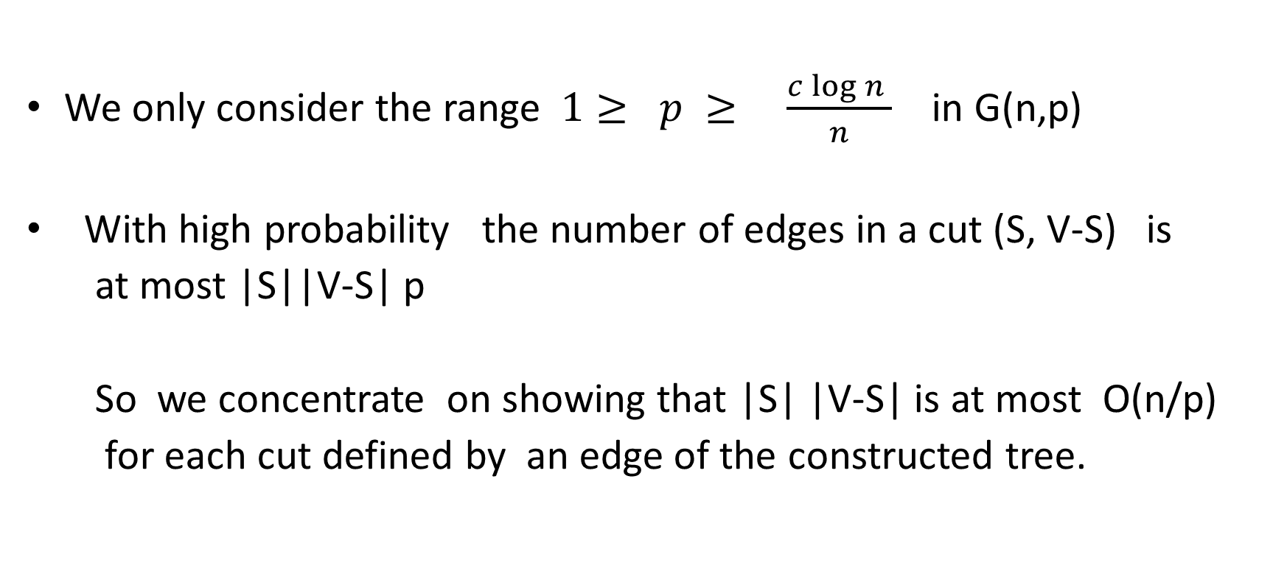
Random Graphs:
We only consider the range $1≥ p ≥ \frac{c\log{n }}{n}$ in G(n,p)
With high probability the number of edges in a cut (S, V-S) is
at most |S||V-S| p
So we concentrate on showing that |S| |V-S| is at most O(n/p)
for each cut defined by an edge of the constructed tree.

Slide 42
This can be achieved if we make sure that the subtree rooted
at each child of the root has at most O(1/p) vertices.

Slide 43
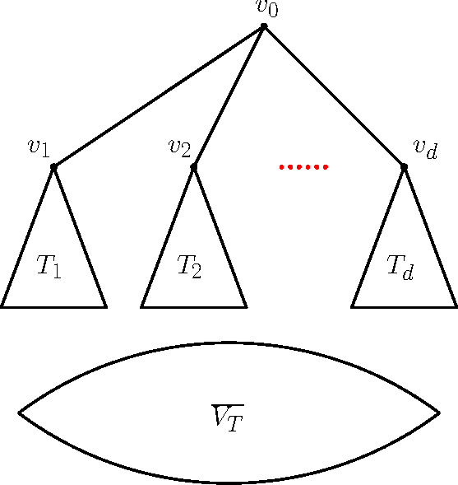

Slide 44
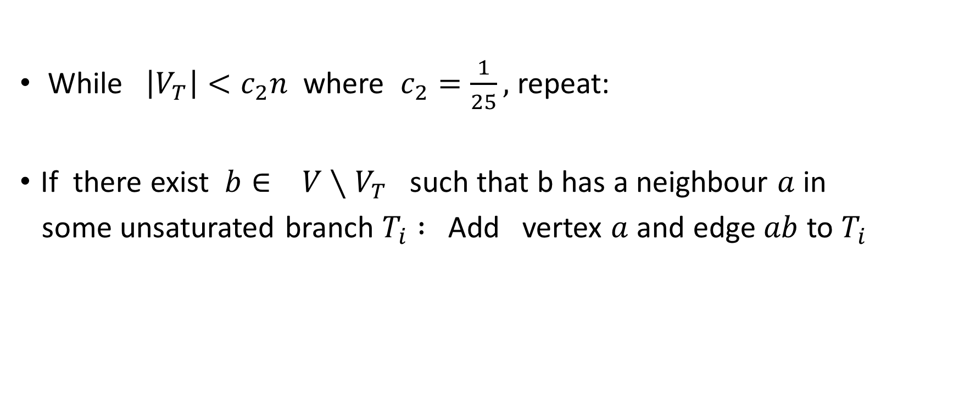
Algorithm for random graphs: Phase 1
While $\left|V_{T}\right|<c_{2}n$ where $c_{2}=\frac{1}{25},$ repeat:
If there exist $b∈ V∖V_{T}$ such that b has a neighbour $a$ in
some unsaturated branch $T_{i} :$ Add vertex $a$ and edge $ab$ to $T_{i}$

Slide 45
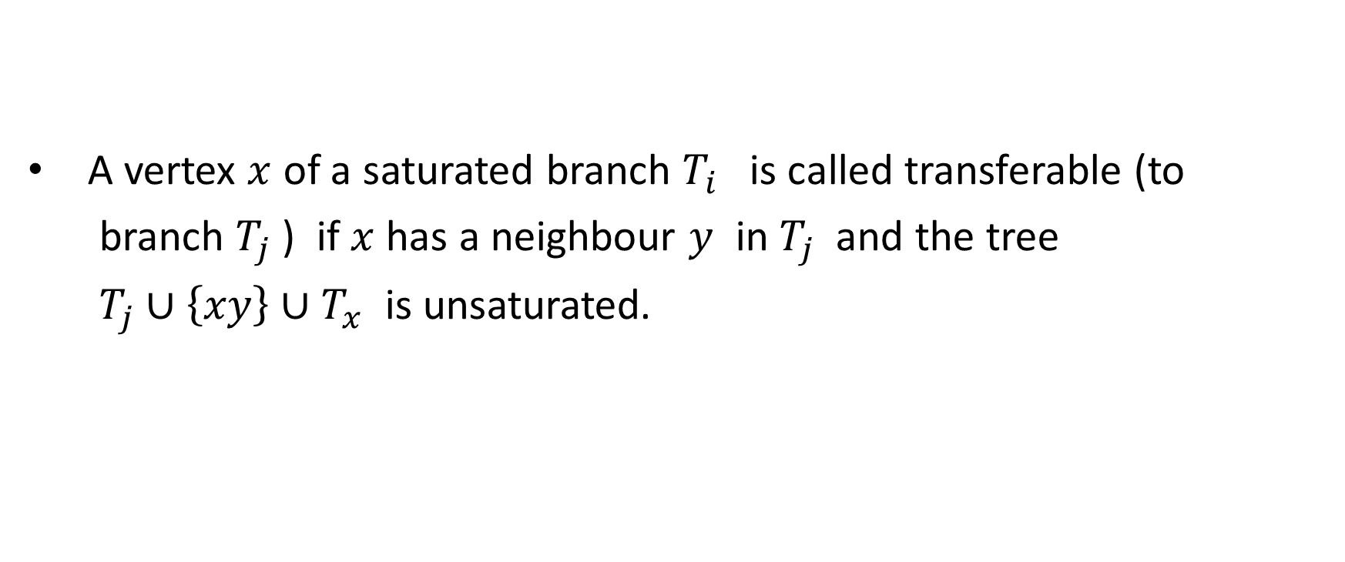
Transferable vertex
A vertex $x$ of a saturated branch $T_{i}$ is called transferable (to
branch $T_{j}$ ) if $x$ has a neighbour $y$ in $T_{j}$ and the tree
$T_{j}∪\left\{xy\right\}∪T_{x}$ is unsaturated.

Slide 46
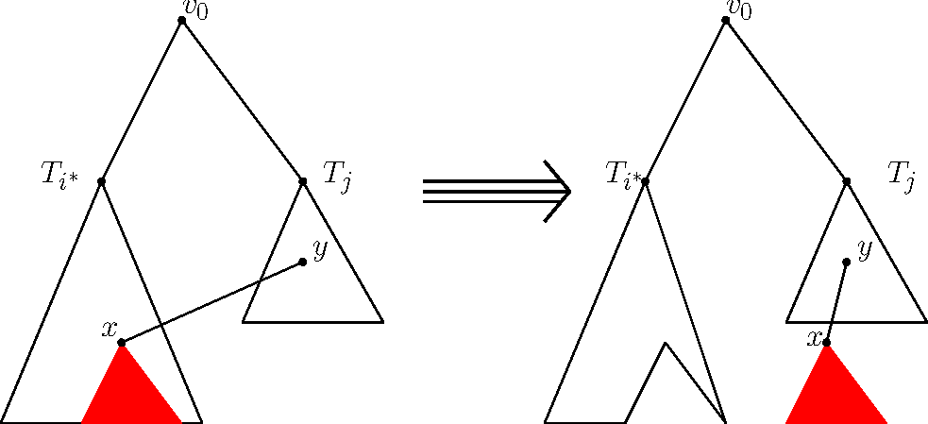

Slide 47
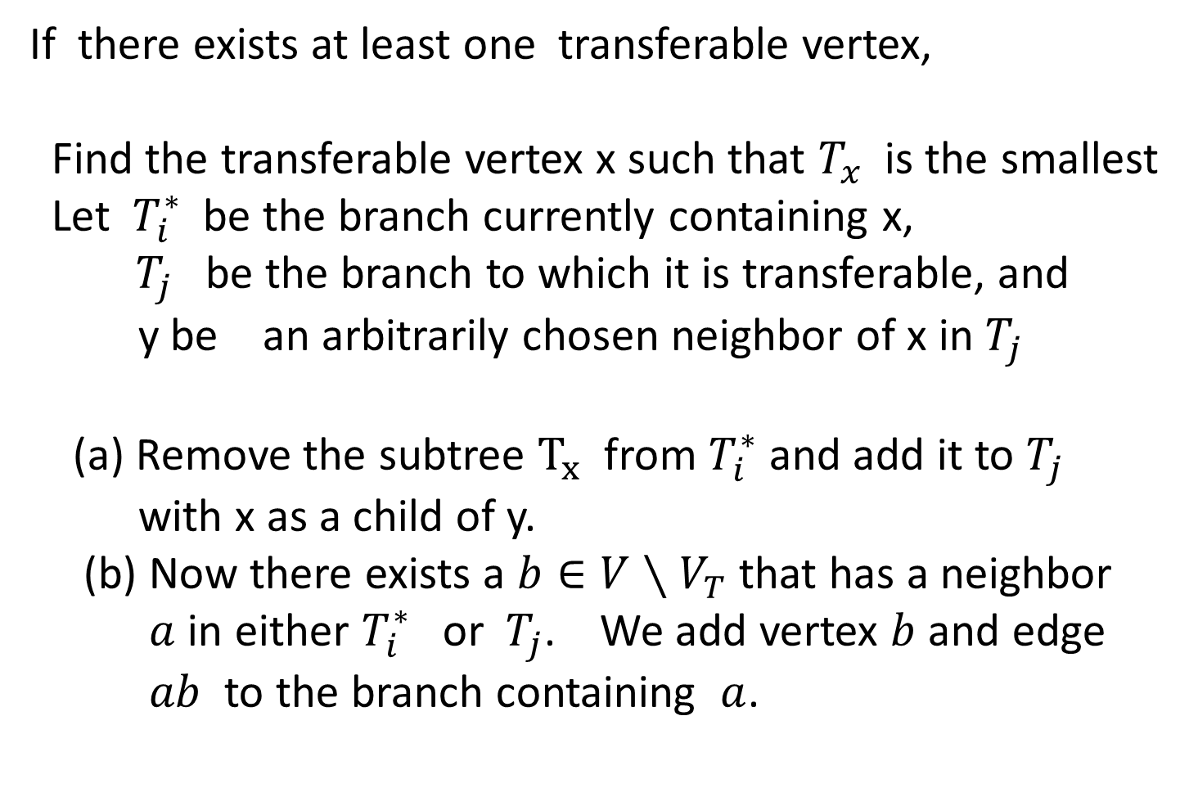
If there exists at least one transferable vertex,
Find the transferable vertex x such that $T_{x}$ is the smallest
Let $T_{i}^{∗}$be the branch currently containing x,
$T_{j}$ be the branch to which it is transferable, and
y be an arbitrarily chosen neighbor of x in $T_{j}$
(a) Remove the subtree $T_{x}$from $T_{i}^{∗}$and add it to $T_{j}$
with x as a child of y.
(b) Now there exists a $b∈V∖V_{T}$that has a neighbor
$a$ in either $T_{i}^{∗}$or $T_{j}$. We add vertex $b$ and edge
$ab$ to the branch containing $a$.

Slide 48
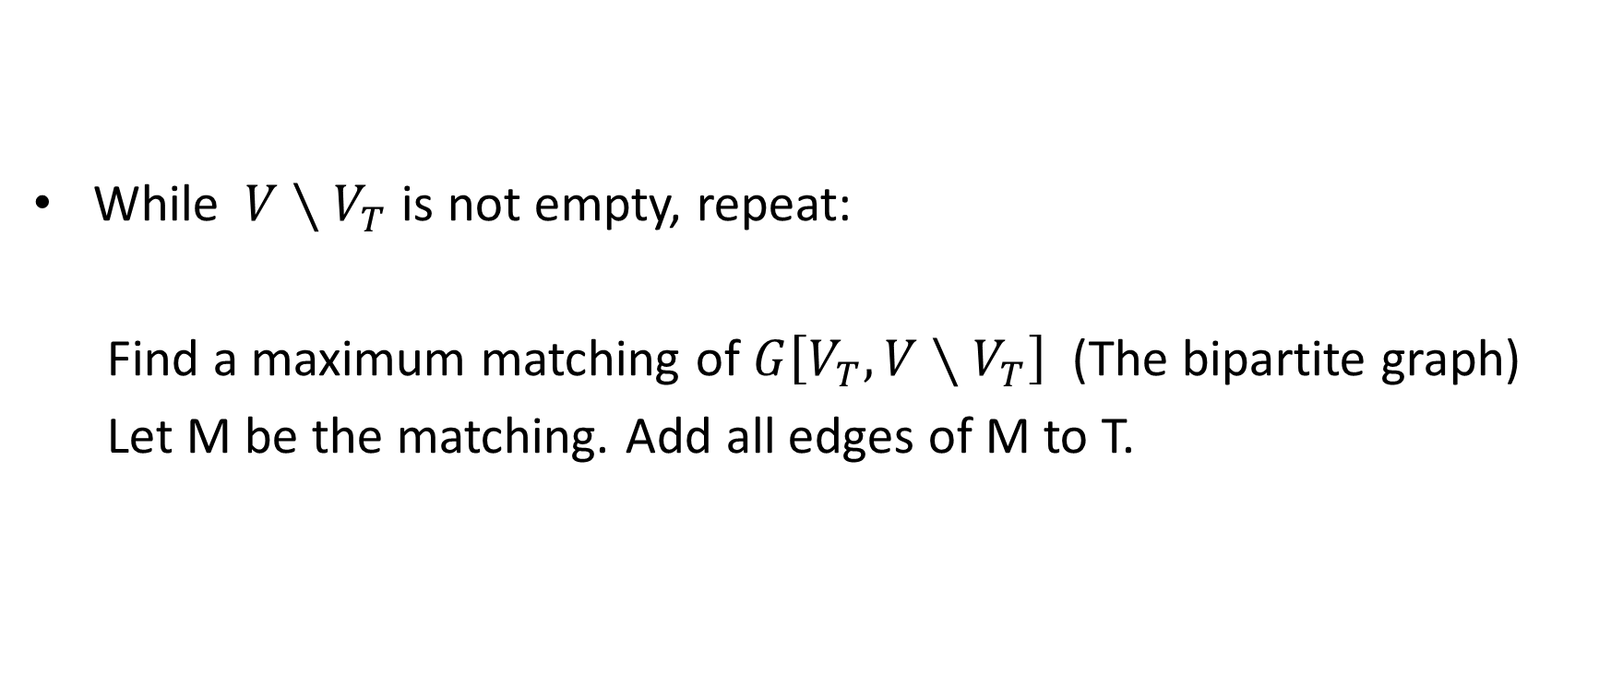
Phase: 2.
While $V∖V_{T}$ is not empty, repeat:
Find a maximum matching of $G\left[V_{T}, V∖V_{T}\right]$ (The bipartite graph)
Let M be the matching. Add all edges of M to T.

Slide 49
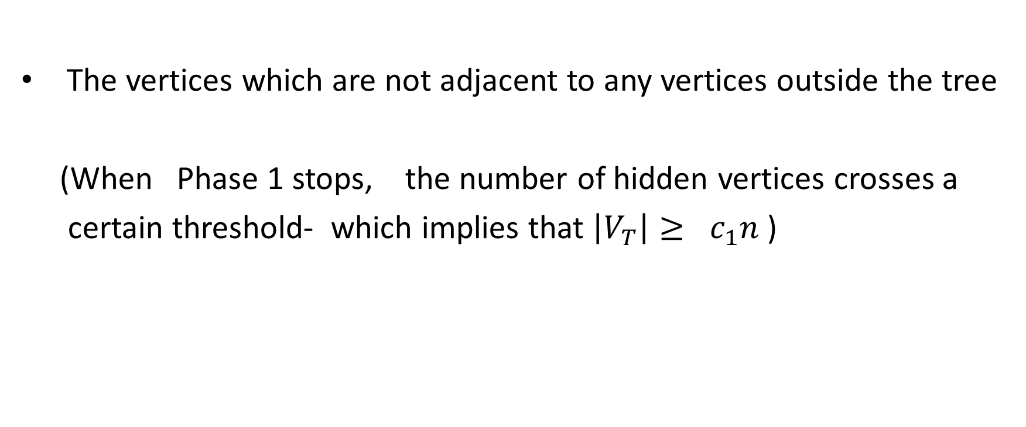

Hidden vertices $H_{T}$of T
The vertices which are not adjacent to any vertices outside the tree
(When Phase 1 stops, the number of hidden vertices crosses a
certain threshold- which implies that $\left|V_{T}\right|≥ c_{1}n$)

Slide 50
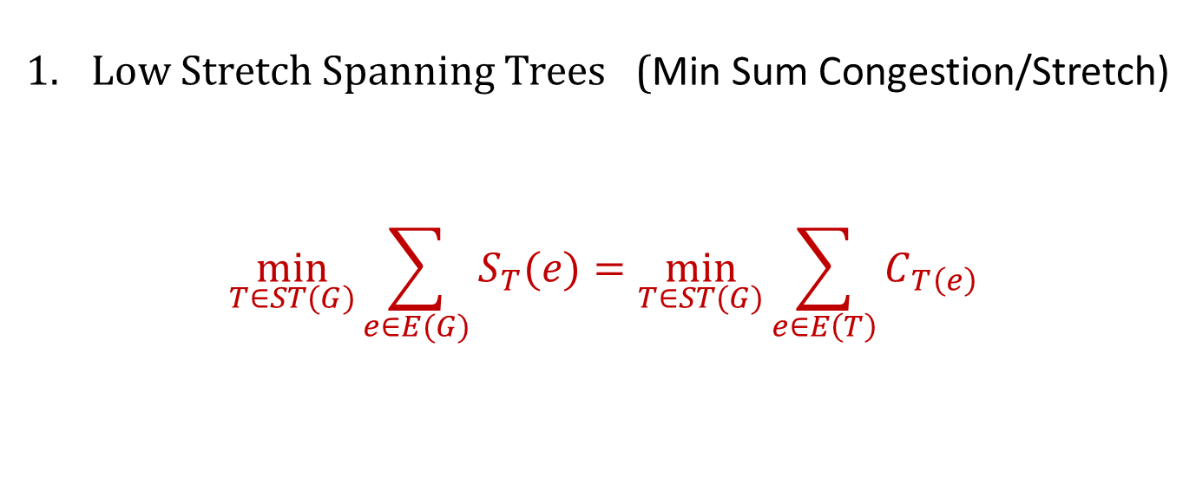
Lemma: For any $S⊆V(G)$ such that $\left|S\right|=\left\lceil \frac{1}{p}\right\rceil$ we have $\left|N\left(S\right)\right|≥c_{2}n$ with probability at least $1−e^{−\frac{n}{16}}$
Lemma: For any $S⊆V\left(G\right)$ such that $\left|S\right|≤\frac{1}{p}$ we have $\left|N\left(S\right)\right|≥c_{3}np \left|S\right|$ with probability at least $1−O\left(\frac{1}{n^{2}}\right)$ where $c_{3}=1/16$

Slide 51
For all $A ⊆V\left(G\right)$such that $\left|A\right|≤\frac{n}{2}$ with probability at least $1−e^{−n }$ there exists a matching of size at least $\left|A\right|−\frac{c_{4}}{p}$ from A to $V\left(G\right)∖A$ in G, where $c_{4}=12$
Lemma: for all $S⊆V\left(G\right)$such that $\left|S\right|≤\frac{c}{p}$ the cut size C(S) is
at most 8cn with probability at least $1−2^{−cn/2}$

