Slide 1
Integer multicommodity flow in series-parallel graphs
Nikhil Kumar, IITD
Joint work with Hannaneh Akrami (Sharif U), Naveen Garg (IITD)

Slide 2
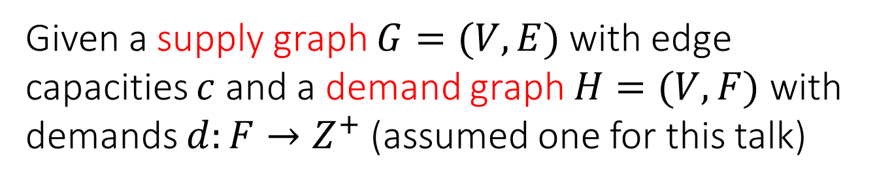
Multicommodity flow
Given a supply graph $G=(V,E)$with edge capacities $c$ and a demand graph $H=(V,F)$ with demands $d:F→Z^{+}$ (assumed one for this talk)
[integral routing] Find a path between end points of every demand s.t. #paths through an edge does not exceed its capacity.
[fractional routing] 1 unit of flow is sent between end points of each demand.
1/2

Slide 3
Cut condition
For demands to be (fractionally) routable the capacity of every cut should exceed demand across it.
The cut condition is necessary but not sufficient.
(total volume of edges required: 8, available: 6)
(2,2)
(3,3)
(3,1)
(3,3)
(capacity, demand)

Slide 4
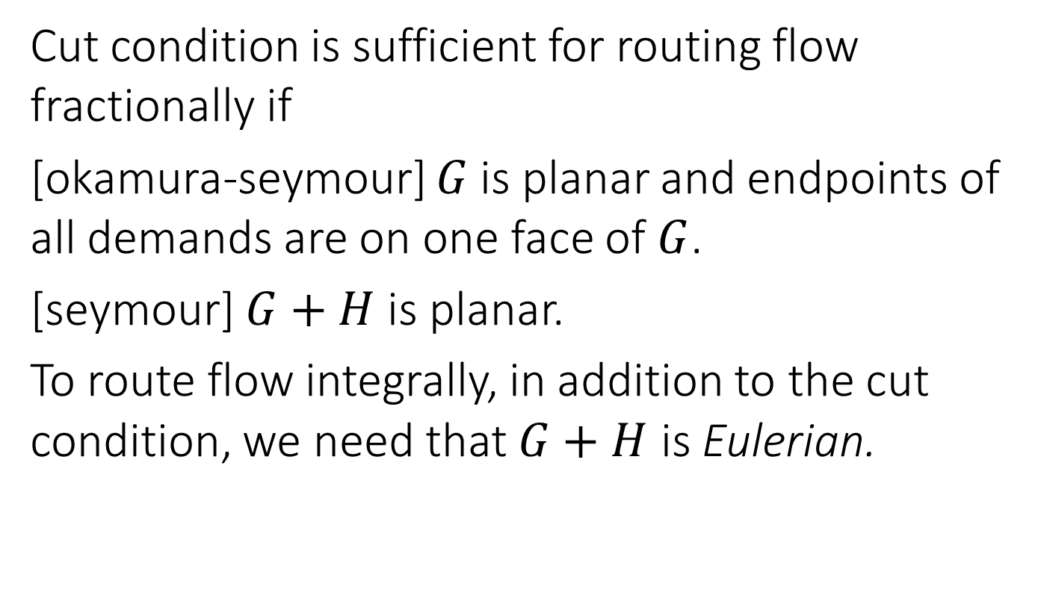
Sufficiency of the cut condition
Cut condition is sufficient for routing flow fractionally if
[okamura-seymour] $G$is planar and endpoints of all demands are on one face of $G$.
[seymour] $G+H$ is planar.
To route flow integrally, in addition to the cut condition, we need that $G+H$ is Eulerian.

Slide 5
Series-parallel graphs
[parallel-paths graph] Graph obtained by identifying endpoints of 2 or more simple paths.
[series-parallel graph] start with a pp-graph, replace edges by other pp-graphs and repeat.
s
t

Slide 6
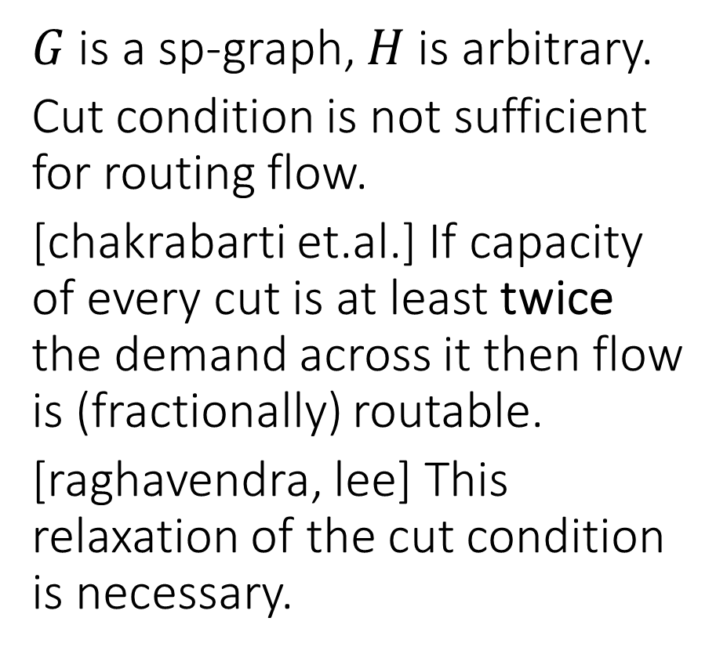
Multicommodity flow in sp-graphs
$G$is a sp-graph, $H$is arbitrary.
Cut condition is not sufficient for routing flow.
[chakrabarti et.al.] If capacity of every cut is at least twice the demand across it then flow is (fractionally) routable.
[raghavendra, lee] This relaxation of the cut condition is necessary.

Slide 7
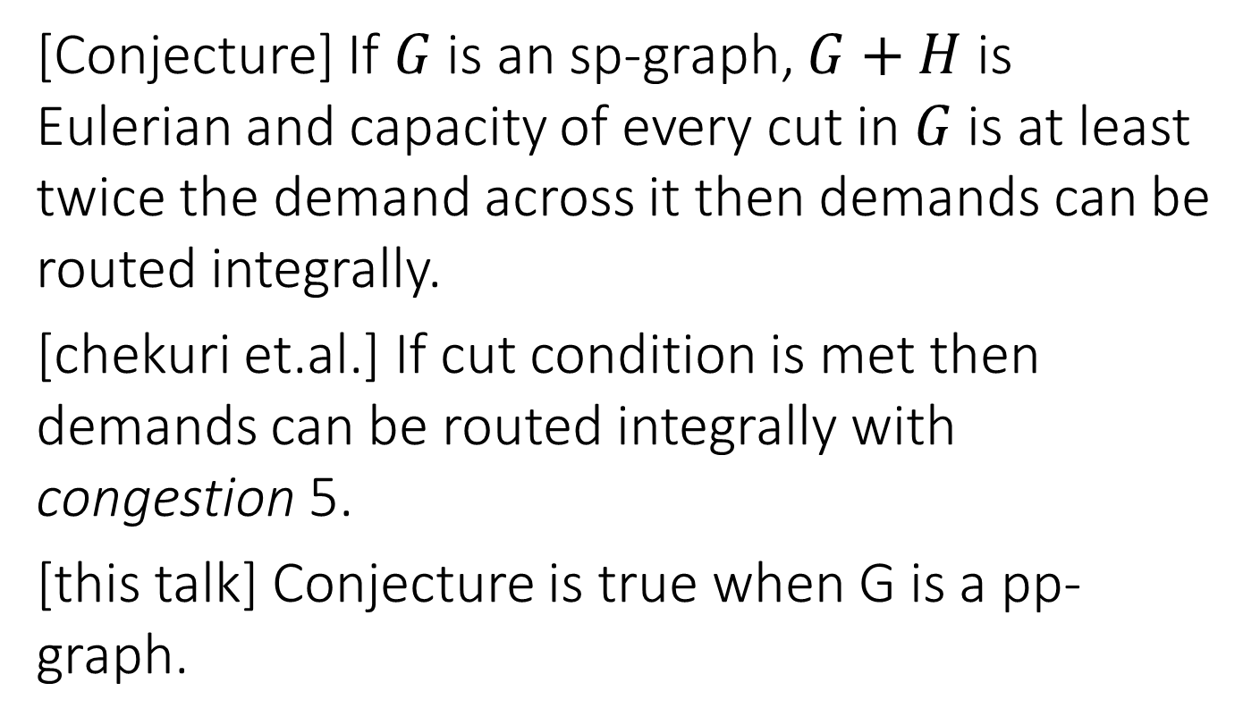
Integral flow in sp-graphs
[Conjecture] If $G$is an sp-graph, $G+H$ is Eulerian and capacity of every cut in $G$is at least twice the demand across it then demands can be routed integrally.
[chekuri et.al.] If cut condition is met then demands can be routed integrally with congestion 5.
[this talk] Conjecture is true when G is a pp-graph.

Slide 8
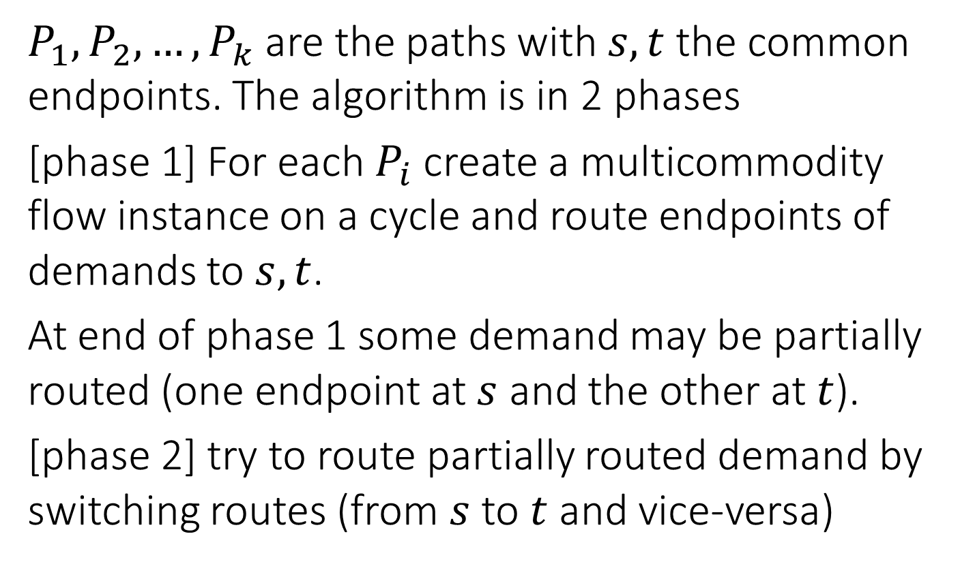
Algorithm for pp-graphs
$P_{1},P_{2},…,P_{k}$ are the paths with $s,t$ the common endpoints. The algorithm is in 2 phases
[phase 1] For each $P_{i}$ create a multicommodity flow instance on a cycle and route endpoints of demands to $s,t$.
At end of phase 1 some demand may be partially routed (one endpoint at $s$ and the other at $t$).
[phase 2] try to route partially routed demand by switching routes (from $s$ to $t$ and vice-versa)

Slide 9



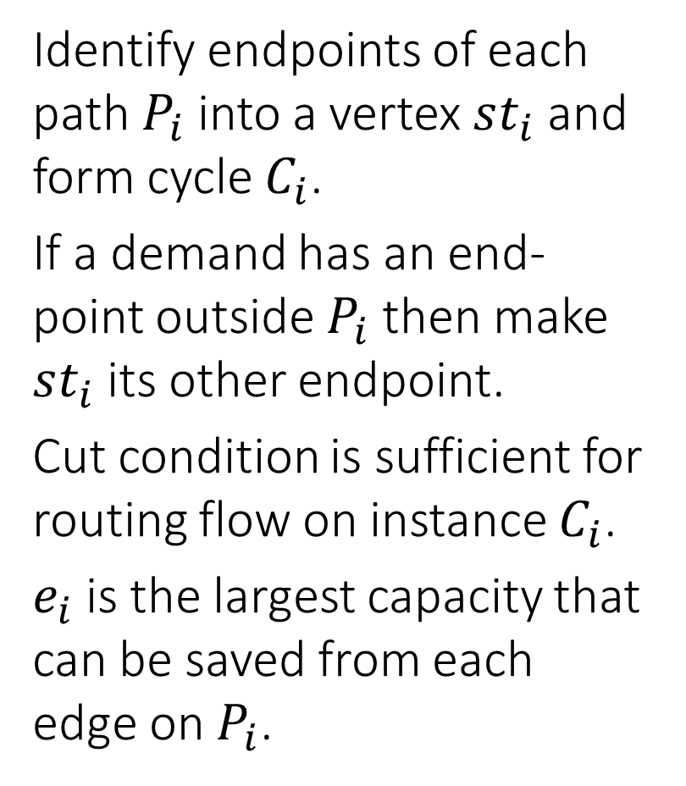



Phase 1
Identify endpoints of each path $P_{i}$ into a vertex $st_{i}$ and form cycle $C_{i}$.
If a demand has an end-point outside $P_{i}$ then make $st_{i}$ its other endpoint.
Cut condition is sufficient for routing flow on instance $C_{i}$.
$e_{i}$ is the largest capacity that can be saved from each edge on $P_{i}$.
1
1
1
s
4
3
2
3
4
t
3
2
2
3
$$st_{1}$$
$$st_{2}$$
$$st_{3}$$
a
d
a
c
a
b
b
c
b
$$e_{1}=0$$
$$e_{2}=2$$
$$e_{3}=1$$

Slide 10
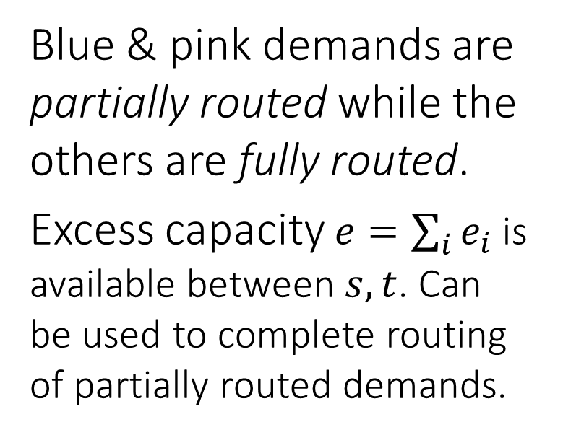
At the end of Phase 1
Blue & pink demands are partially routed while the others are fully routed.
Excess capacity $e=\sum_{i}{e_{i}}$ is available between $s, t$. Can be used to complete routing of partially routed demands.
1
1
1
s
4
3
2
3
4
t
3
2
2
3
e

Slide 11

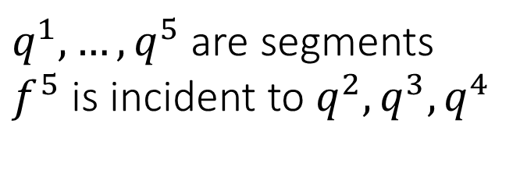










Phase 2
[segment] part of a path between two consecutive tight edges.
A non-tight edge has residual capacity at least 2.
A demand is incident to a segment if the path along which it is routed contains a vertex of the segment
$$q^{1}$$
$$f^{3}$$
$$q^{2}$$
$$q^{3}$$
$$f^{5}$$
$$f^{6}$$
$$q^{4}$$
$$f^{4}$$
$$f^{2}$$
$$q^{5}$$
$$f^{1}$$
$q^{1},…,q^{5}$ are segments
$f^{5}$ is incident to $q^{2},q^{3},q^{4}$

Slide 12
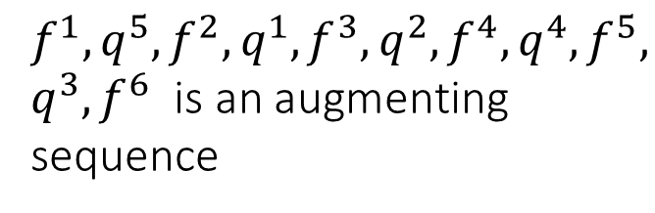
Alternating sequence
a sequence in which alternate elements are segments and (fully routed) demands (endpoints on different paths).
All segments and demands are distinct.
Each demand is incident to its adjacent segments in the sequence.
Consecutive demands are routed through different ends.
If the first and last demands are partially routed then we call it an augmenting sequence.
$$q^{1}$$
$$f^{3}$$
$$q^{2}$$
$$q^{3}$$
$$f^{5}$$
$$f^{6}$$
$$q^{4}$$
$$f^{4}$$
$$f^{2}$$
$$q^{5}$$
$$f^{1}$$
$$f^{1},q^{5},f^{2},q^{1},f^{3},q^{2},f^{4},q^{4},f^{5},$$
$q^{3},f^{6}$ is an augmenting sequence

Slide 13







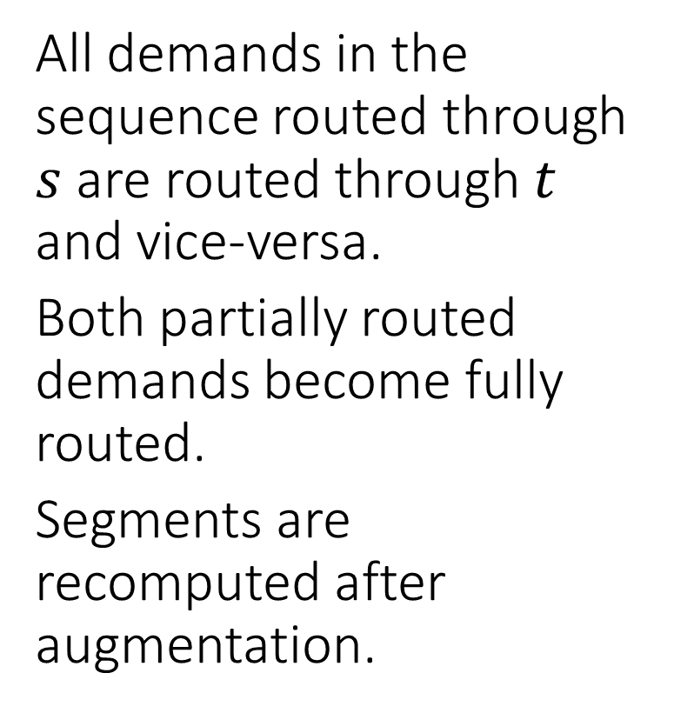










Flipping augmenting sequences
All demands in the sequence routed through $s$ are routed through $t$ and vice-versa.
Both partially routed demands become fully routed.
Segments are recomputed after augmentation.
$$q^{1}$$
$$f^{3}$$
$$q^{2}$$
$$q^{3}$$
$$f^{6}$$
$$f^{5}$$
$$q^{4}$$
$$f^{4}$$
$$f^{2}$$
$$f^{1}$$
$$q^{5}$$
$$f^{3}$$
$$f^{6}$$
$$f^{5}$$
$$f^{4}$$
$$f^{2}$$
$$f^{1}$$

Slide 14









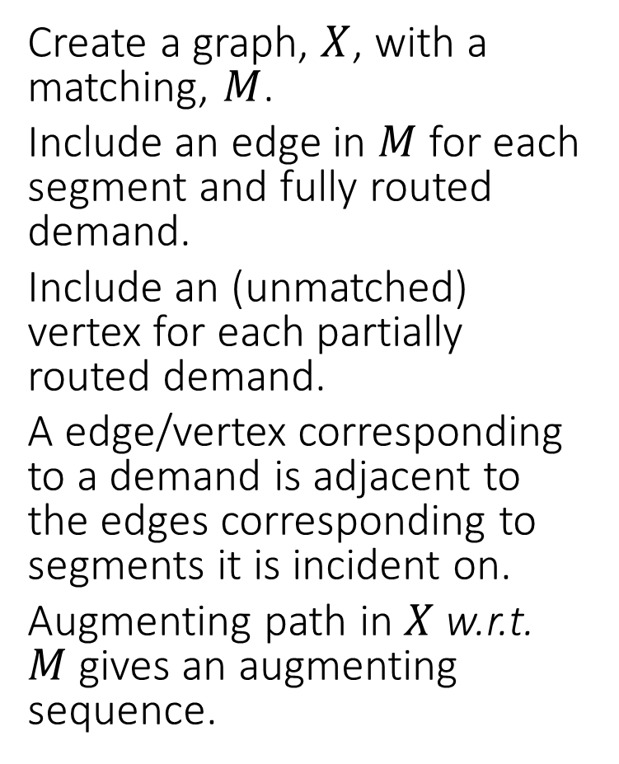














Finding an augmenting sequence
Create a graph, $X$, with a matching, $M$.
Include an edge in $M$for each segment and fully routed demand.
Include an (unmatched) vertex for each partially routed demand.
A edge/vertex corresponding to a demand is adjacent to the edges corresponding to segments it is incident on.
Augmenting path in $X$w.r.t. $M$gives an augmenting sequence.
$$q^{1}$$
$$f^{3}$$
$$q^{2}$$
$$q^{3}$$
$$f^{6}$$
$$f^{5}$$
$$q^{4}$$
$$f^{4}$$
$$f^{2}$$
$$f^{1}$$
$$q^{5}$$
$$q^{1}$$
$$f^{3}$$
$$q^{2}$$
$$f^{4}$$
$$q^{3}$$
$$f^{5}$$
$$q^{4}$$
$$f^{2}$$
$$q^{5}$$
$$f_{6}$$
$$v_{f_{1}}$$
$$v_{f_{6}}$$

Slide 15
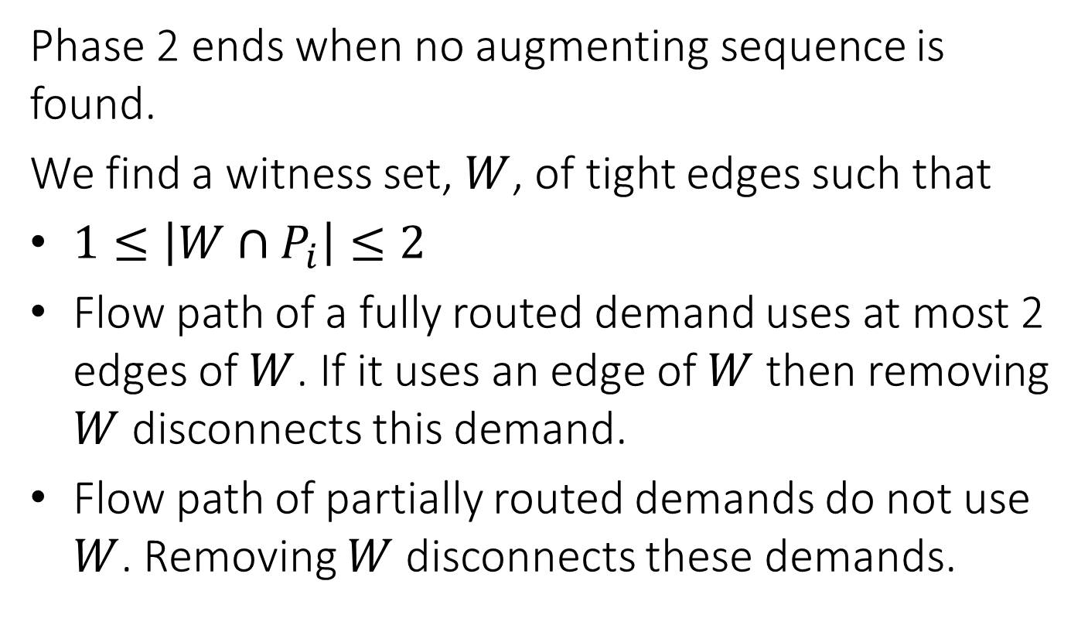
End of Phase 2
Phase 2 ends when no augmenting sequence is found.
We find a witness set, $W$, of tight edges such that
$1≤\left|W∩P_{i}\right|≤2$
Flow path of a fully routed demand uses at most 2 edges of $W$. If it uses an edge of $W$then removing $W$disconnects this demand.
Flow path of partially routed demands do not use $W$. Removing $W$disconnects these demands.

Slide 16
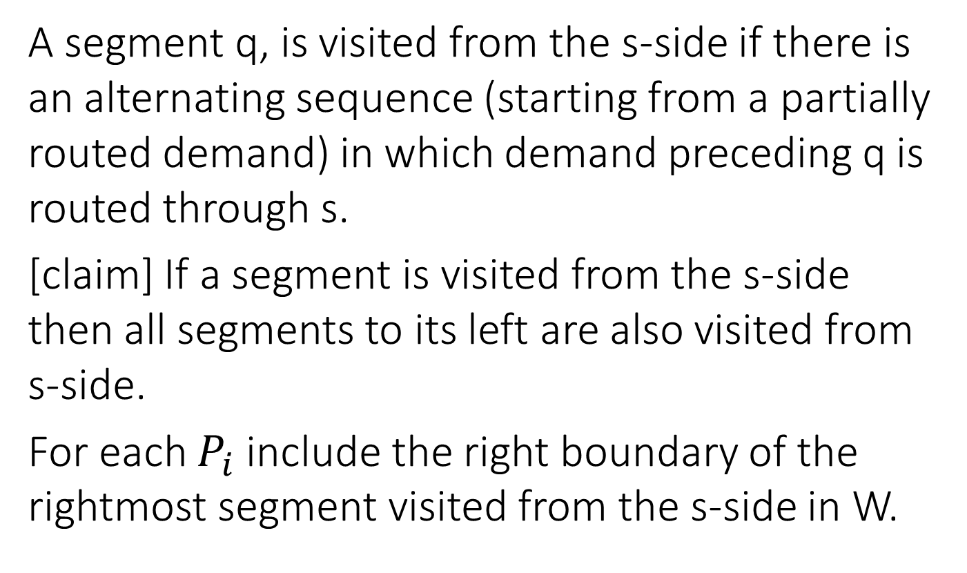
How to pick W?
A segment q, is visited from the s-side if there is an alternating sequence (starting from a partially routed demand) in which demand preceding q is routed through s.
[claim] If a segment is visited from the s-side then all segments to its left are also visited from s-side.
For each $P_{i}$ include the right boundary of the rightmost segment visited from the s-side in W.

Slide 17
Why should no flow path go over more than 2 edges of W?
We need to drop some edges picked in W. choice of these edges depends on the blossoms encountered in the algorithm for finding an alternating path in X.

Slide 18
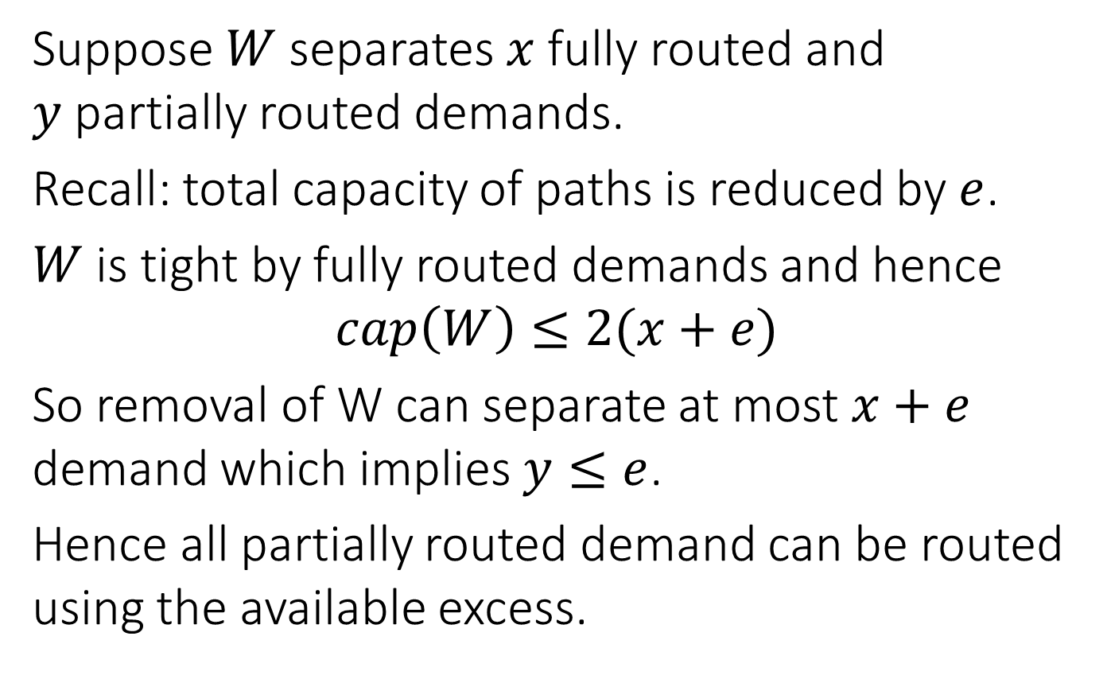
Analysis
Suppose $W$separates $x$fully routed and $y$partially routed demands.
Recall: total capacity of paths is reduced by $e$.
$W$is tight by fully routed demands and hence
$$cap\left(W\right)≤2(x+e)$$
So removal of W can separate at most $x+e$ demand which implies $y≤e$.
Hence all partially routed demand can be routed using the available excess.

Slide 19
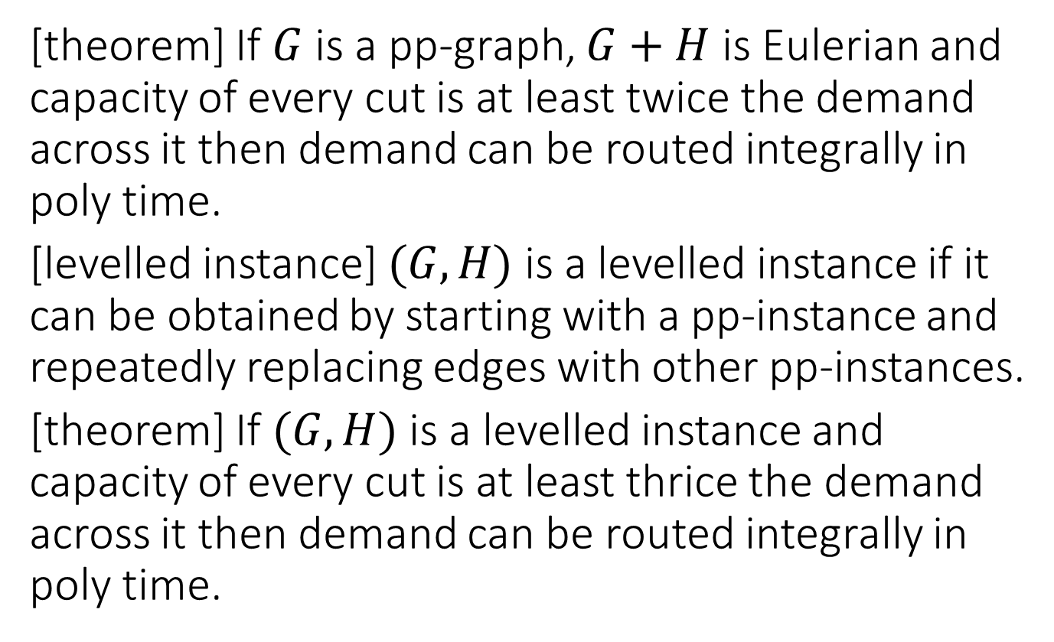
Key results
[theorem] If $G$ is a pp-graph, $G+H$ is Eulerian and capacity of every cut is at least twice the demand across it then demand can be routed integrally in poly time.
[levelled instance] $(G,H)$is a levelled instance if it can be obtained by starting with a pp-instance and repeatedly replacing edges with other pp-instances.
[theorem] If $(G,H)$ is a levelled instance and capacity of every cut is at least thrice the demand across it then demand can be routed integrally in poly time.

Slide 20
Open Questions
Proving the conjecture for sp-graphs.
A tight max multicommodity flow min multicut result for sp-graphs.
[BIG ONE] Is relaxing cut condition by a constant factor sufficient to route flow (fractionally) in planar graphs.

Slide 21
Thank you for your attention

Slide 22























$$q^{1}$$
$$q^{1}$$
$$f^{3}$$
$$f^{3}$$
$$q^{2}$$
$$f^{4}$$
$$q^{2}$$
$$q^{3}$$
$$q^{3}$$
$$f^{5}$$
$$f^{6}$$
$$f^{5}$$
$$q^{4}$$
$$q^{4}$$
$$f^{4}$$
$$f^{2}$$
$$q^{5}$$
$$f^{2}$$
$$f_{6}$$
$$q^{5}$$
$$f^{1}$$
$$v_{f_{1}}$$
$$v_{f_{6}}$$

